Slide 1

Architecture for a Neuroadaptive Coding Experience
Integrative Masters Project 2022
16.12.2022
Jonas Hermann and Kay Erik Jenss

Slide 2




Motivation
Eye Tracking Data
Processing
Cognitive Load Measurement
Intervention
Notes:
You could also mention that the system is meant (long-term) to provide support / interventions in the presence of high CL. Thus, the need for „real time“ and a robust measure
CL -> latency-> Pupil dilation
Challenging

Slide 3



Requirements
(Near) Real Time Feedback
Measure Cognitive Load
Extensibility
Notes:
You could also mention that the system is meant (long-term) to provide support / interventions in the presence of high CL. Thus, the need for „real time“ and a robust measure
CL -> latency-> Pupil dilation
(Near) Real Time: Low latency between data collection and cognitive load results
Measurable Cognitive Load: Reliable and robust metrics for cognitive load
Extensibile Should be easy to add new metrics and modalities

Slide 4



Milestone
Too Slow !
HTTP
Websocket
< 200 ms
~5 min
< 200 ms
Notes:
First Prototype based on Nifi -→ Way too slow
No real time feedback if it takes 5 minutes between read

Slide 5
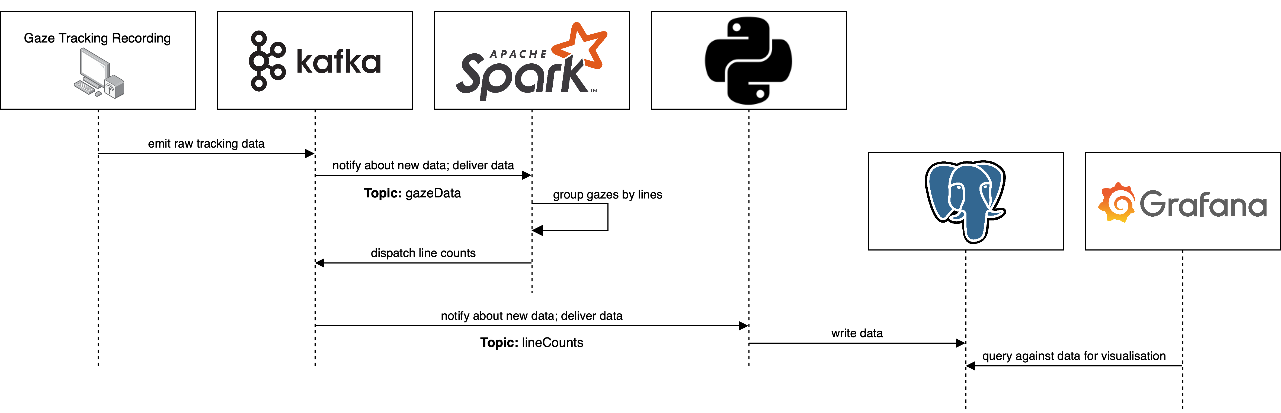
Prototype
Notes:
With animations step by step
Grafana plug new metrics -> Extensibility

Slide 6
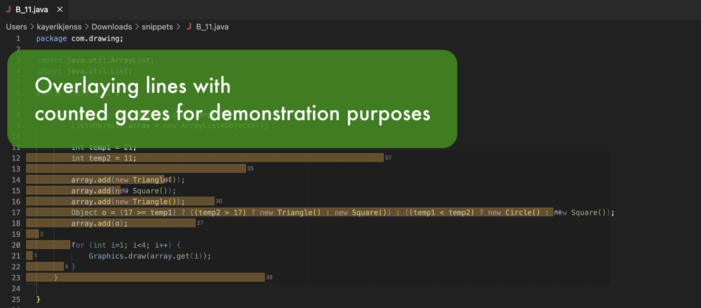


Measure
Notes:
In 1

Slide 7
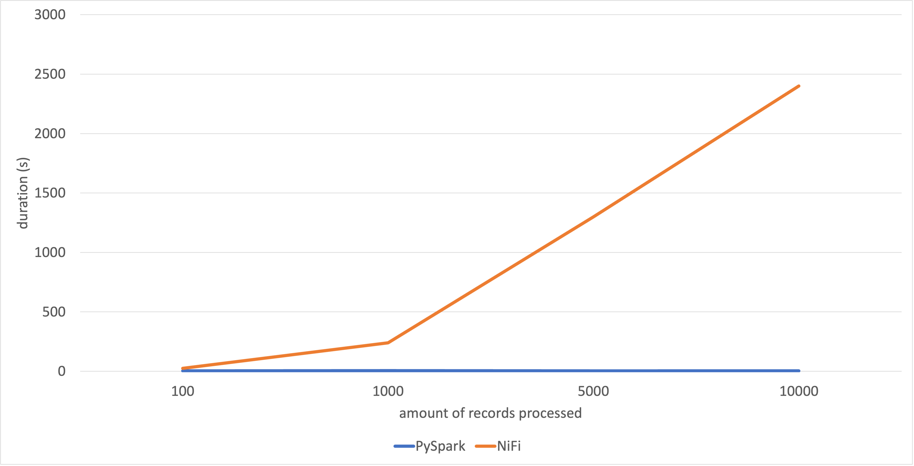

Measure
2400
5
Notes:
In 1

Slide 8
Prototype
Notes:
With animations step by step
Grafana plug new metrics -> Extensibility

Slide 9






Why Spark?
Popular & Usable
Extensions & Python API
Low Latencies & High Throughput
https://ieeexplore.ieee.org/abstract/document/7530084
https://ieeexplore.ieee.org/abstract/document/7530084
Notes:
FinThe Popular & Usable: Used by Amazon, Yahoo!, Baidu, eBay(https://spark.apache.org/powered-by.html) //Arround till 2014 and still maintained, Documentation & Community available (https://www.toptal.com/spark/introduction-to-apache-spark) https://data-flair.training/blogs/apache-storm-vs-spark-streaming/
Extensibility & Python API: Spark MLLIB -> train and use models on streaming data (https://spark.apache.org/mllib/) // all the others usually have just scala and java // Good integration //Paper SparkHadoopML
Low Latencies & High Throughput: Good for handling gaze samples as data comes in with relatively high frequency → See papers for further reference
https://data-flair.training/blogs/hadoop-vs-spark-vs-flink/
Add the paper

Slide 10


Spark Structured Streaming
11
11
9
8
11
12
12
11
13
14
12
14
14
13
15
Count Based Metrics
Line | Count
8 | 1
9 | 1
11 | 3
Line | Count
8 | 1
9 | 1
11 | 4
12 | 2
13 | 1
14 | 1
Line | Count
8 | 1
9 | 1
11 | 4
12 | 3
13 | 2
14 | 3
15 | 1
Notes:
Batch vs Stream Processing:
Stream processing for „real time“ systems -> every record is processed exclusively -> lower latency
Batch processing for not real time systems -> records are processed in batches -> higher latency but more efficient -> more throughput
Micro Batching -> Best of both worlds -> Relatively low latency but better throughput
->https://sqlstream.com/5-reasons-why-spark-streamings-batch-processing-of-data-streams-is-not-stream-processing/ Spark > Storm on word count metric
http://blog.ditullio.fr/2015/10/31/mini-cluster-part-iv-word-count-benchmark/
-> Spark is the best tool in the wordcount benchmark -> pretty much perfect for the line counting task

Slide 11


Extension – New Metric
Multiple Samples
Sliding Windows
Notes:
Yellow mark

Slide 12



Spark Structured Streaming
Complex Windowing
11
12
12
13
14
13
15
15
14
13
13
12
15
15
16
17
17
17
16
15
Notes:
https://sqlstream.com/5-reasons-why-spark-streamings-batch-processing-of-data-streams-is-not-stream-processing/

Slide 13


Potential Solution
~
Notes:
Kafka pub sub

Slide 14

Future Work
Extensibility
Interventions

Slide 15
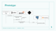


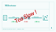














Thank You !
We:
Built a solid foundation for cognitive load calculation
Increased performance for line count metric towards online functionality
Made system extensible for future extension

